Slide 1
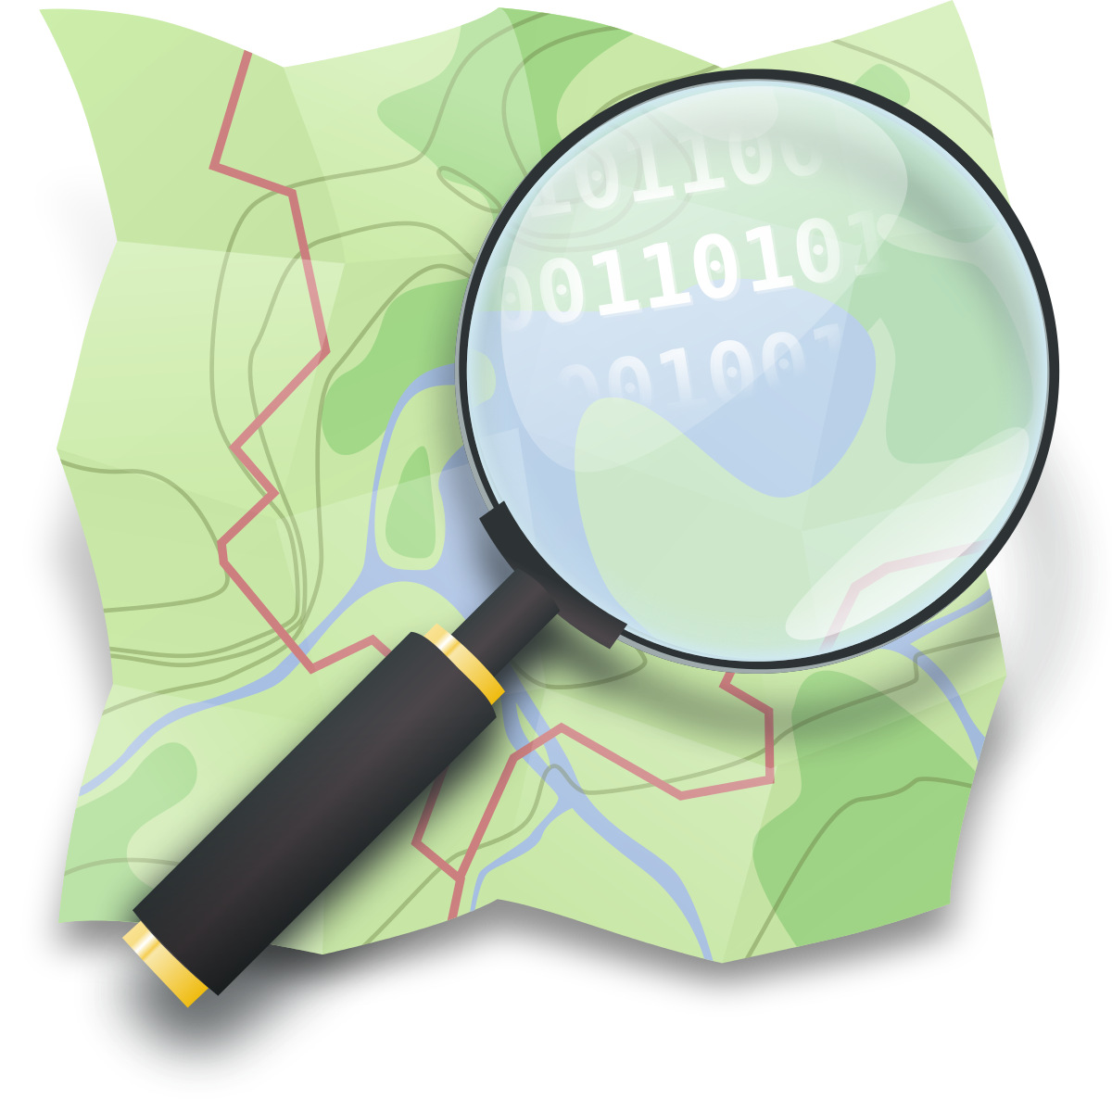
OSM Tools

Slide 2
OSM has a diverse ecosystem
Difficult to know them all
Constant movement
A tool for everything – I highlight a few common usecases

Slide 3
Overview
A personal webmap: umap
On your website: leaflet
Research: Overpass
On your phone: OsmAnd

Slide 4
A secret
I didn’t really prepare this part

Slide 5
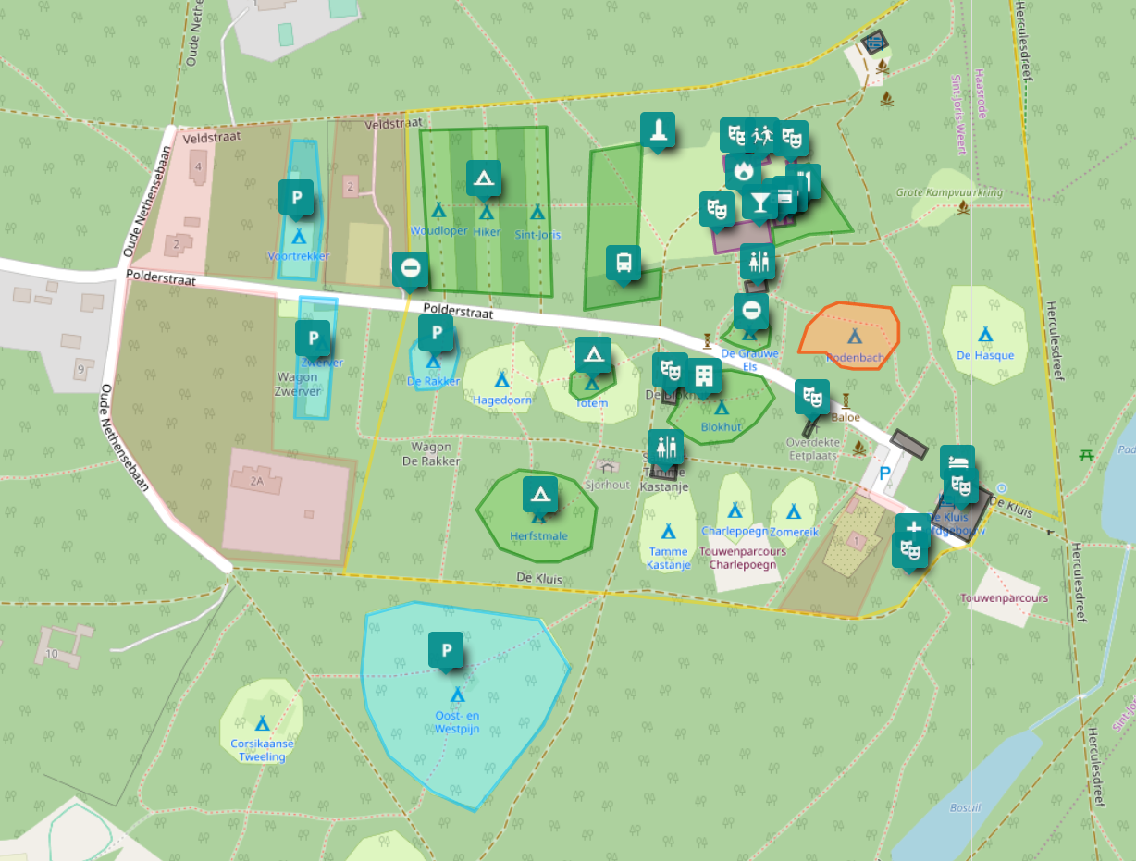
UMap
Ideal to add geodata not suited for OSM itself
  Preparing an event
  Planning a route
  ...

Slide 6
Leaflet
Small & friendly JS-library
Just check out their documentation, it is great!

Slide 7
Overpass
Ever wondered how many X there are in Y?
Easily query the OSM-database
Can be used to create an on-the-fly, automatically up-to-date map
Lots of complicated features
10’000 queries/day

Slide 8
StreetComplete
Really cool app to quickly contribute ‘on the go’
Especially useful for maxspeed, road surface, opening hours, …
Can not add new points – only add tags

Slide 9
On mobile: navigation apps
OsmAnd
Maps.me
Magic Earth
…
Something for everyone: some are paid, some are simple, some can do a lot, some have ads, some respect your privacy, some are crappy...

